Slide 1
B2B KT Session 1
High Level Architecture & Data Flow Overview

Slide 2
Overview
Statuses + Status Flows
B2B Repository Organisation
Architectural dive
Retry flows
Data
Logging Information
Production Support Tool

Slide 3
Statuses: Event Statuses vs Payment Statuses
Event Statuses: Statuses providing granular information at every step of a disbursement’s journey (e.g OFAC_CLEARED, REQUEST_ACCEPTED)
Payment Statuses: A subset of event statuses that provide simplified, key disbursement information to our clients (e.g IN_PROGRESS, PAID, STOPPED)
A complete list of statuses and all status information can be found here: https://libertymutual.atlassian.net/wiki/spaces/CPH/pages/1634720958/B2B+Channel+OneInc+Statuses

Slide 4
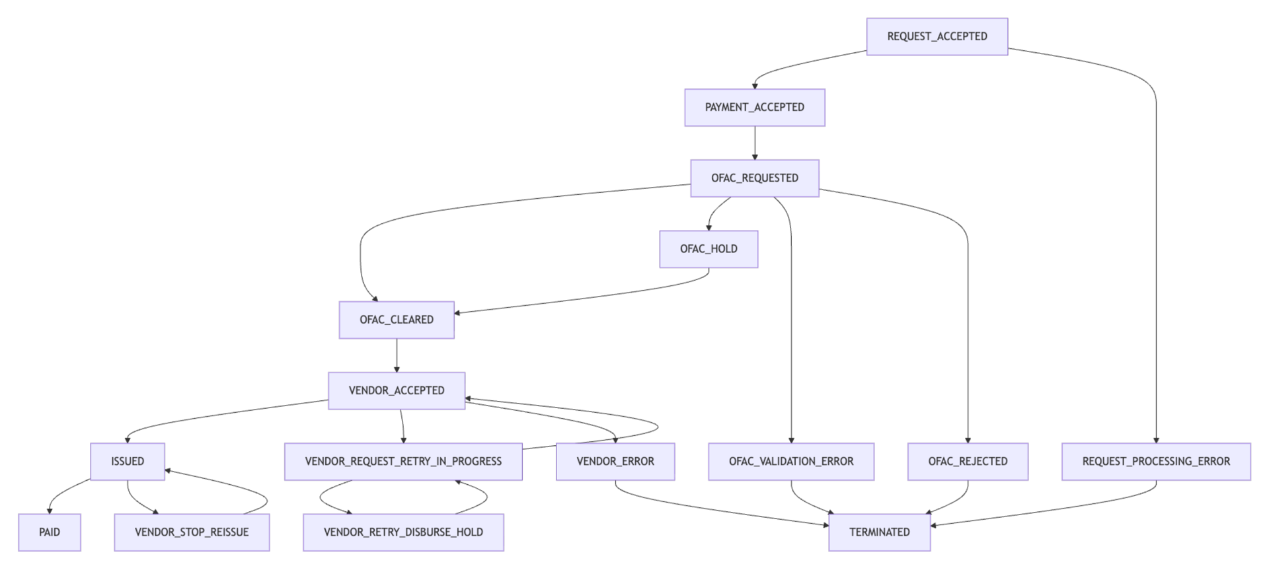
Status Flows: Disbursements 1
Event Status Flow

Slide 5
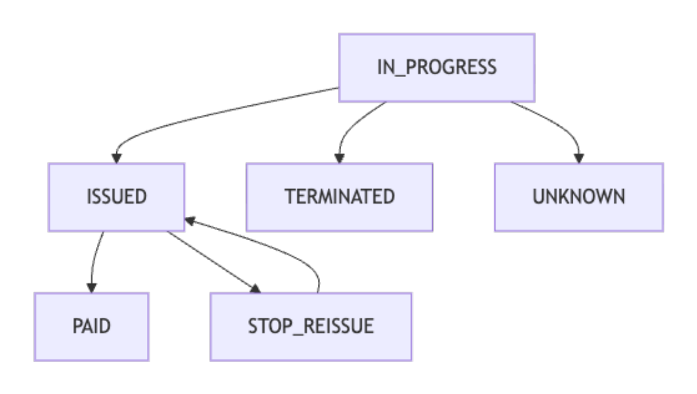
Status Flows: Disbursements 2
Payment Status Flow

Slide 6
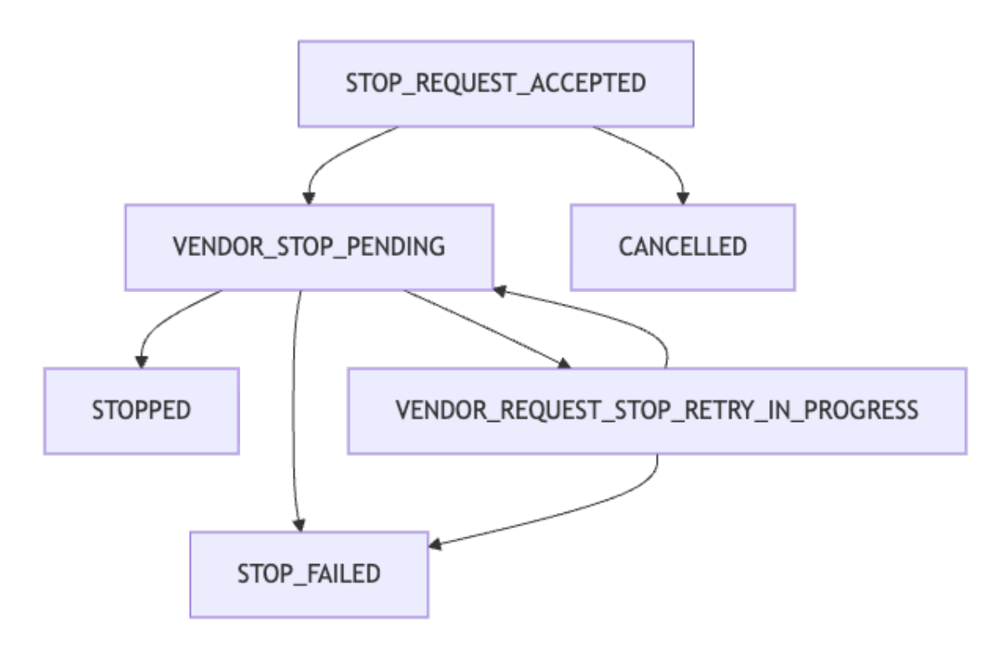
Status Flows: Cancellations 1
Event Status Flow

Slide 7
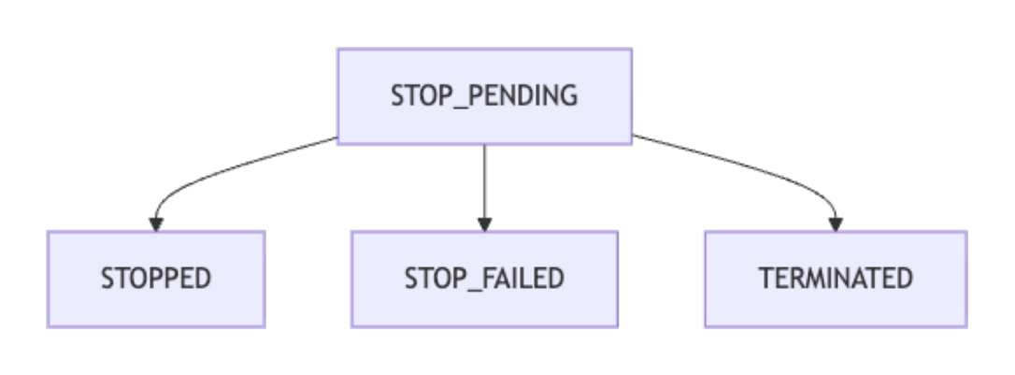
Status Flows: Cancellations 2
Payment Status Flow

Slide 8
B2B Repository Organisation
List of key B2B Repositories:
paymenthub-b2b-service (main repository doing most of the payment processing)
paymenthub-oneinc-adapter (used as an adapter that contains logic specific to our vendor, oneinc)
paymenthub-b2b-webhooks (used solely for webhook verification and processing)
paymenthub-b2b-service-infrastructure (used for provisioning infrastructure in AWS)
paymenthub-document-service (not solely b2b but contains attach documents solution)

Slide 9
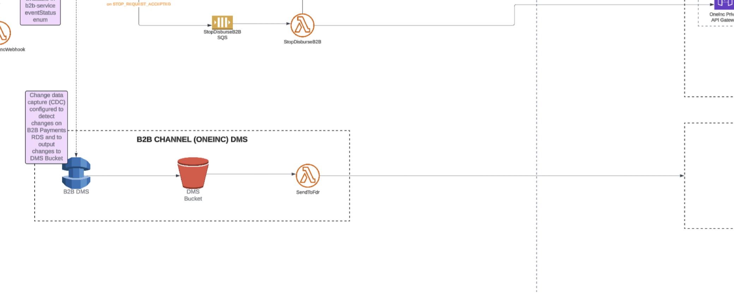
Architectural Dive

Slide 10
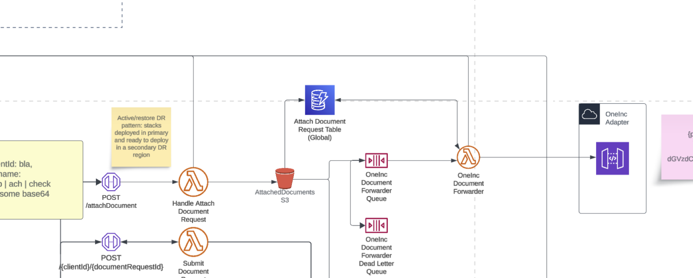
Architectural Dive: Attach Documents

Slide 11
Retry Flows
Disbursements: 3 retry queues using exponential backoff to retry the disbursement request to OneInc which goes via the OneInc Adapter. If all retries fail the disbursement request is put in a VENDOR_RETRY_DISBURSE_HOLD state where we can retry manually
Cancellations: Same logic as disbursements but instead of a manual retry, we inform our client that the disbursement is unable to be stopped and they should contact OneInc to stop it.
Attach Documents: Up to 10 retries with exponential backoff, if that fails, we can manually retry the request

Slide 12
Data
Postgres: Holds all payment information
Dynamo: Used to log attached document information
S3: Used to store documents being attached
Cloudwatch: Has all logs for lambdas and API Gateway
Datadog: Logs are sent to Datadog with enhanced logging for increased transparency, dashboard creation and ease of access

Slide 13
Dependencies
Client Service
Status Notification Service
OFAC Service
DMS
OneInc
Tokenisation Service

Slide 14
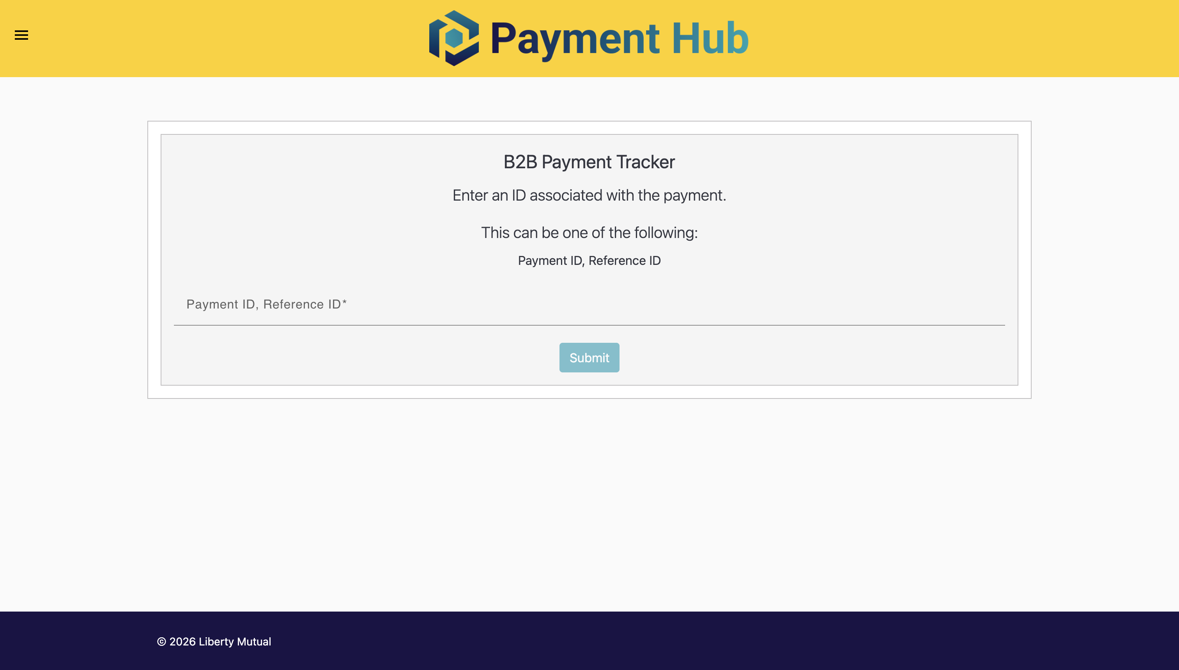
Production Support Tool
Can be used to view payment information
https://phub-support.lmig.com/b2b/payment-tracker

Slide 15
Any Questions?

